Slide 1
Year 9 CPR – Autumn 1: Does God Exist?
Task 1: Communicate your initial thoughts
1. Do you believe in the existence of a God? Why do you believe/not believe in a god?
2. Make a mind map of any reasons that you can think of that someone would believe in a god.
3. Make a second mind map of any reasons you can think of that someone might not believe in a god.
Task 2: Enquiring into different beliefs
Use the BBC Bitesize site here https://www.bbc.co.uk/bitesize/guides/zpxpr82/revision/1 to complete the following tasks:
In your own words, write a definition for theist, agnostic and atheist.
Use page 5 of the link above to make some notes on what arguments people have both for and against the existence of God in Christianity.
Use page 7 of the link above to read about religious experience. Do you think that religious experience is enough to prove the existence of a god?
Task 3: Beliefs about how the world began
Read through the creation story here, and create a storyboard of the Christian view of the creation story. There is a template on slide 2 to help you.
Read through the information on the Big Bang theory here and summarise the theory in your own words.
Is it possible for someone to believe in both the scientific theory and the religious theory? Explain your ideas.
Watch the video here and read through pages 3 and 4 here. Add anything extra to your notes about how someone might be able to believe in both the Christian and Scientific theories.
Task 4: Conclusion
Overall, do you think that it can be proven that there is a god? Explain your answer using examples from both viewpoints.
Take it further
There are lessons on Oak National Academy to support your learning on this topic – please look here for these https://classroom.thenational.academy/units/non-religious-world-views-137b
Towards the end of this half term, we will begin the next topic, which begins by learning about the political system in the UK.
Learn the key words and definitions here and complete the activity.
Complete the task here.
Read through the information here and complete this Google form quiz.
Remember to stay safe when doing research online. If you see something that worries you, speak to a trusted adult (parent/teacher).
If you need help with any of the tasks, or if you have completed them, please email Miss Colmer for feedback on colmer-rachael@Mayfield.portsmouth.sch.uk

Slide 2
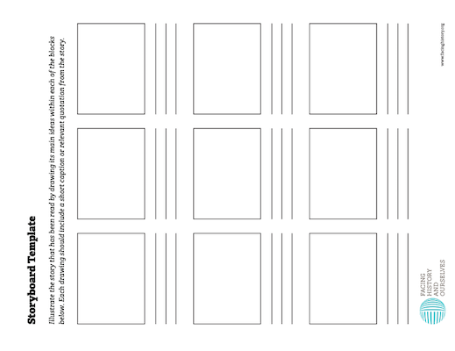
Notes:
You could print the images on this slide and the next if you wished for students to annotate, or just use as a class discussion ​

